Slide 1


Dept of ECE

Slide 2


Slide 3
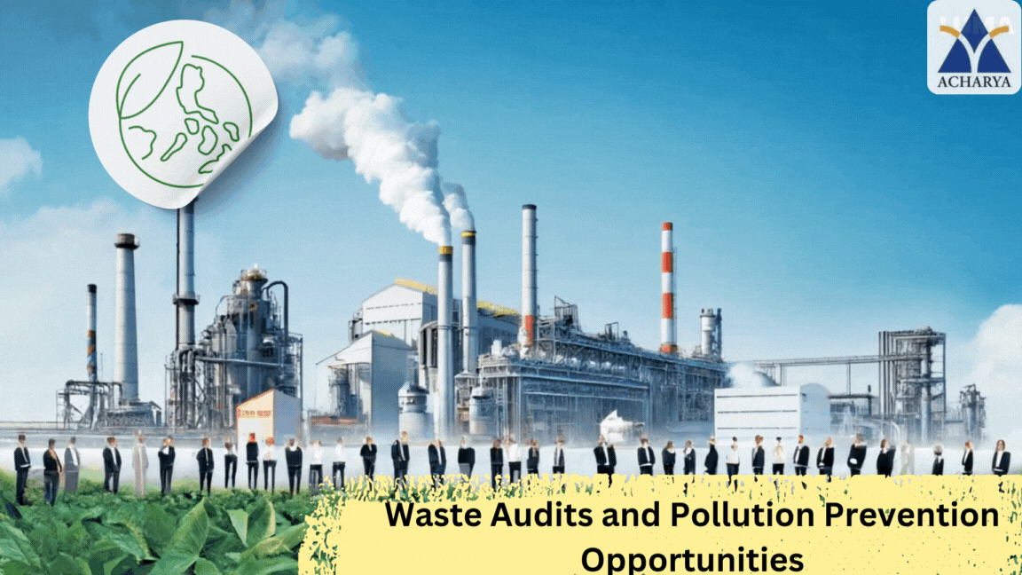

Slide 4
Srushti Slides

Slide 5

Definition of Waste Audits
Evaluates waste management
Reduces costs
Ensures compliance
Dept of ECE

Slide 6
Importance of Pollution Prevention
Minimizes environmental harm
Conserves resources
Enhances public image
Dept of ECE

Slide 7
Overview of Industries Covered
Textile Industry
Sugar Industry
Pulp and Paper Industry
Electroplating Industry
Tanning Industry
Dairy Industry
Cement Industry
Chemical Industry
Dept of ECE

Slide 8
Waste Audits in the Textile Industry
Overview of Textile Waste
Types: Water discharge, chemical runoff, energy waste.
Impact: Pollutes water bodies, depletes oxygen, harms soil productivity.
Waste Audit Procedures
Data: Gather waste data from processes like dyeing, sizing, and bleaching.
Analysis: Evaluate waste composition and identify inefficiencies.
Dept of ECE

Slide 9

Waste Audits in the Textile Industry
Pollution Prevention Opportunities
Water: Reduce and recycle water in processes like dyeing and washing.
Chemicals: Replace toxic substances with eco-friendly alternatives.
Practices: Implement air dyeing, reuse treated effluents, and adopt best practices.
Dept of ECE

Slide 10
Waste Audits in the Sugar Industry
Overview of Sugar Waste
Waste types: Water, effluents, sludge
Environmental impact: Pollution, soil degradation
Waste Audit Procedures
Monitoring: Freshwater usage tracking
Effluents: Analyzing waste generation patterns
Dept of ECE

Slide 11
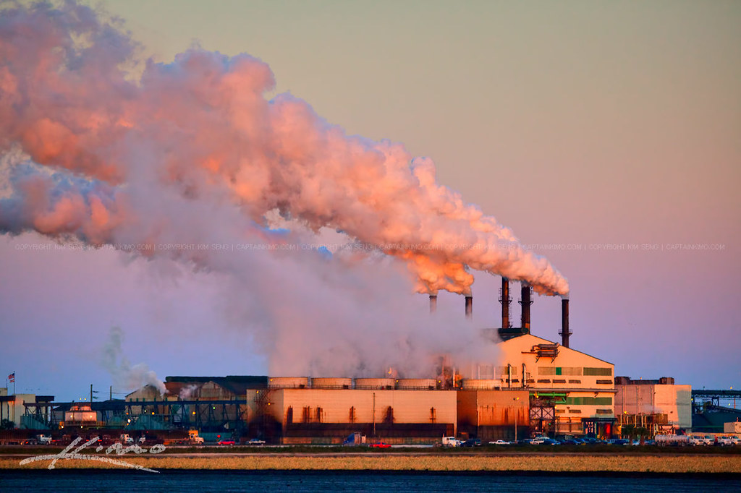
Waste Audits in the Sugar Industry
Pollution Prevention Opportunities
Water recycling: Effective reuse methods
Waste minimization: Strategic reduction techniques
Energy recovery: Utilize process by-products
Dept of ECE

Slide 12
Rahul Slides

Slide 13
Overview of Pulp & Paper Industry Waste
Types of Waste Generated
Wastewater: Washing, pulping, bleaching.
Solid Waste: Handling, screening, sludge.
Air Emissions: Sulfur, SO₂, NOx.
Environmental Impact
Water: Pollution.
Soil: Contamination.
Air: Degradation.
Dept of ECE

Slide 14
Waste Audit Procedures
Wastewater Treatment Analysis
Primary: Clarifiers.
Biological: Aeration, sludge.
Segregation: Targeted.
Solid Waste Management
Reuse: Recycling.
Sludge: Dewatering.
Dept of ECE

Slide 15
Pollution Prevention Opportunities
Process Optimization
Water: Recycling.
Bleaching: Recirculation.
Housekeeping: Efficient.
Chemical Recovery Techniques
Black Liquor: Recovery.
Relime: Reuse.
Lime: Optimization.
Dept of ECE

Slide 16
Pollution Prevention Opportunities
Use of Alternative Raw Materials
Bagasse: Renewable.
Enzymes: Biodegradable.
Recycling: Fibers.
Dept of ECE

Slide 17
Waste Audits in the Electroplating Industry
Overview of Electroplating Industry Waste
Types: Cyanide, chromium, cadmium, solvents, sludges.
Impact: Groundwater, air, and soil contamination.
Waste Audit Procedures
Chemical Usage: Evaluate inefficiencies.
Wastewater: Analyze pollutants.
Pollution Prevention Opportunities
Process Modification: Optimize systems.
Recovery & Recycling: Reuse chemicals.
Non-toxic Alternatives: Safer substitutes.
Dept of ECE

Slide 18
Rakshita Slides

Slide 19
Overview of Tanning Industry Waste
Types of Waste Generated
Liquid Waste: Wastewater containing high levels of organic and inorganic contaminants.
Solid Waste: Fleshings, trimmings, and shavings.
Gaseous Emissions: Volatile organic compounds (VOCs) and odoriferous gases
Environmental Impact
Water Pollution: Discharge of untreated or poorly treated effluent.
Soil Contamination: Improper disposal of solid waste.
Air Pollution: Emission of VOCs and malodorous gases.
Biodiversity Loss: Impact on aquatic and terrestrial ecosystems.
Dept of CSE

Slide 20
Waste Audit Procedures
Monitoring Water and Chemical Usage
Water Usage
Measure water input and effluent output.
Optimize water recycling and reuse.
Chemical Usage
Maintain a detailed inventory of chemicals.
Substitute hazardous chemicals with eco-friendly alternatives.
Solid Waste Management
Segregation: Separate biodegradable, recyclable, and hazardous waste.
Recycling: Convert fleshings and shavings into value-added products.
Composting: Organic waste for soil amendment.
Disposal: Environmentally compliant disposal methods for non-recyclable waste.
Dept of CSE

Slide 21
Pollution Prevention Opportunities
Cleaner Production Techniques
Adoption of wet-white tanning to reduce chromium pollution.
Use of enzymes for dehairing instead of chemicals.
Efficient wastewater treatment technologies like membrane bioreactors.
Integration of renewable energy sources.
Waste Minimization Measures
Process Optimization: Enhance process control to minimize waste.
Raw Material Selection: Use high-quality hides to reduce rework and waste.
Lean Manufacturing: Eliminate unnecessary steps that generate waste.
Dept of CSE

Slide 22
Pollution Prevention Opportunities
Resource Recovery:
Water Recovery: Treat and reuse wastewater.
Chemical Recovery: Recover chromium and other chemicals for reuse.
Energy Recovery: Utilize biogas from anaerobic digestion of organic waste.
Material Recovery: Convert waste into useful by-products (e.g., gelatin from trimmings).
Dept of CSE

Slide 23
Overview of Dairy Industry Waste
Types of Waste Generated
Wastewater: Rich in fats, proteins, lactose, and cleaning agents.
Solid Waste: Includes sludge, packaging, and whey by-products.
Air Emissions: Odor and volatile organic compounds.
Environmental Impact
High BOD and COD affect water bodies.
Nutrient runoff leads to eutrophication.
Improper disposal contaminates soil and water.
Greenhouse gas emissions from energy use.
Dept of CSE

Slide 24
Waste Audit Procedures
Wastewater Management
Pre-treatment: Screening and removal of solids.
Primary treatment: Fats, oils, and grease (FOG) separation.
Biological treatment for organic content.
Advanced methods: Membrane filtration, wetlands.
Solid Waste Analysis
Categorize into recyclable, biodegradable, and hazardous.
Explore composting and animal feed options.
Minimize and recycle packaging waste.
Dept of CSE

Slide 25
Pollution Prevention Opportunities
Wastewater Treatment Innovations
Anaerobic digestion for biogas production.
Advanced oxidation for persistent pollutants.
Use of natural filtration systems like wetlands.
By-product Utilization
Convert whey into protein concentrates.
Use sludge in biogas plants or as fertilizer.
Recover milk solids for additional processing.
Dept of CSE

Slide 26
Pollution Prevention Opportunities
Energy Recovery
Biogas generation from organic waste.
Heat recovery systems for energy savings.
Implement combined heat and power (CHP) systems.
Dept of CSE

Slide 27
Kavya Slides

Slide 28
Overview of cement industry
Waste audits in the cement industry focus on evaluating the types, amounts, and Environmental impact of waste generated during production.
The goal is to identify areas for waste reduction, reuse, and recycling to improve sustainability.
Types of waste:
Solid waste: cement kiln dust (CKD), broken machinery, and scrap materials.
Liquid waste: wastewater from cleaning and cooling systems.
Gaseous emissions: co₂, nox, and particulate matter.
Dept of ECE

Slide 29
Waste audit procedures
Identify waste streams: catalog all types of waste generated.
Measure waste quantities: quantify waste volumes through sampling and monitoring.
Analyze waste: determine sources, disposal methods, and opportunities for waste reduction.
Report findings: propose solutions for improving waste management and sustainability.
Emission monitoring:
Continuous monitoring: use technologies like continuous emission monitoring systems (CEMS).
Track pollutants: monitor gases like co₂, nox, sox, and particulate matter.
Compliance: ensure emissions meet regulatory standards to reduce environmental impact.
Regular testing: conduct periodic inspections and tests for accurate data.
Dept of ECE

Slide 30
Pollution prevention opportunities:
Waste minimization: reduce waste at the source to prevent pollution.
Cleaner production: use energy-efficient technologies and cleaner processes.
Eco-friendly materials: replace harmful materials with safer, more sustainable options.
Process optimization: continuously improve production processes to reduce emissions and waste.
Dept of ECE

Slide 31
Overview of Chemical Industry Waste:
The chemical industry generates a wide range of waste products, including hazardous and non-hazardous waste.
Waste audits are crucial to monitor the quantity, type, and impact of chemical waste generated.
Goals include reducing waste, preventing pollution, and improving sustainability.
Types of waste generated:
Hazardous waste: includes toxic by-products, solvents, acids, and heavy metals.
Non-hazardous waste: organic residues, spent catalysts, and packaging waste.
Gaseous emissions: vocs (volatile organic compounds), methane, and carbon monoxide.
Dept of ECE

Slide 32
Waste audit procedures:
Identify waste streams: catalog the types and sources of waste generated in the chemical processes.
Measure quantities: quantify the amount of waste produced at various stages of production.
Analyze disposal methods: evaluate current disposal methods and identify opportunities for improvement.
Audit report: propose solutions for waste reduction, reuse, and recycling.
Dept of ECE

Slide 33
Pollution prevention opportunities:
Reduce waste at source: implement changes in production processes to reduce waste generation.
Cleaner production techniques: adopt technologies that minimize waste and reduce harmful emissions.
Eco-friendly materials: use safer and more sustainable materials to replace toxic chemicals.
Closed-loop systems: recycle materials within the system to reduce environmental impact.
Dept of ECE

Slide 34
Anish Slides

Slide 35

Definition and Importance of Transboundary Movement of Hazardous Wastes
Definition: Transportation of hazardous waste across international borders for disposal, recycling, or treatment.
Importance:
Environmental Protection: Prevents pollution and protects ecosystems.
Public Health: Reduces health risks from toxic exposure.
Global Responsibility: Shared duty for sustainable waste management.
Economic Considerations: Avoids costly clean-up and legal liabilities.
Dept of ECE

Slide 36

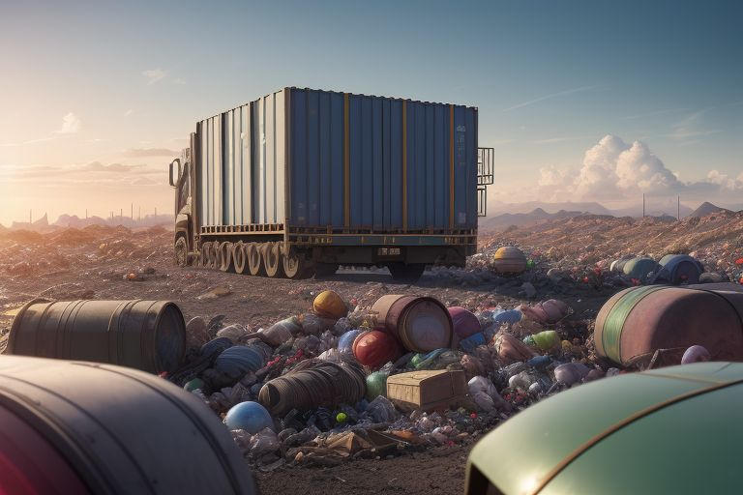
Regulations Governing Transboundary Movement
Basel Convention: Key treaty to reduce hazardous waste movement, requiring prior informed consent.
EU Waste Shipment Regulation: Governs waste movement within/outside the EU, ensuring environmentally sound management.
National Regulations: Countries have specific laws complementing international treaties.
Dept of ECE

Slide 37

Procedures for Compliance
Notification and Consent: Exporters must notify authorities and obtain consent from importing countries.
Documentation: Essential records include waste manifests and contracts.
Tracking and Reporting: Movement must be tracked and reported to ensure compliance.
Compliance with Destination Regulations: Ensure waste meets importing country standards.
Dept of ECE

Slide 38

Case Studies and Examples
Basel Convention Case: Illegal export of hazardous waste from the U.S. to Africa highlighted enforcement needs.
EU Waste Shipment Regulation Example: Legal actions against a member state for improper waste export.
E-Waste Trade: Significant issue with improper management leading to environmental and health impacts.
Dept of ECE

Slide 39

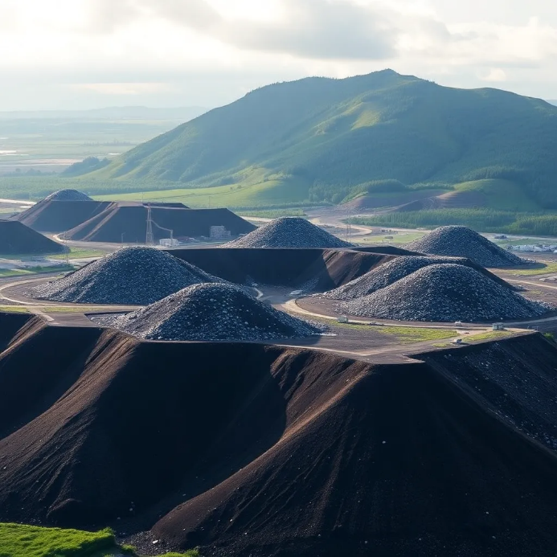
Overview of Disposal Methods
Landfill Disposal: Containment in engineered landfills; requires monitoring and strict regulations.
Incineration: High-temperature burning to reduce volume and toxicity; requires emission control.
Recycling and Recovery: Processing to reclaim resources; must comply with safety regulations.
Dept of ECE

Slide 40

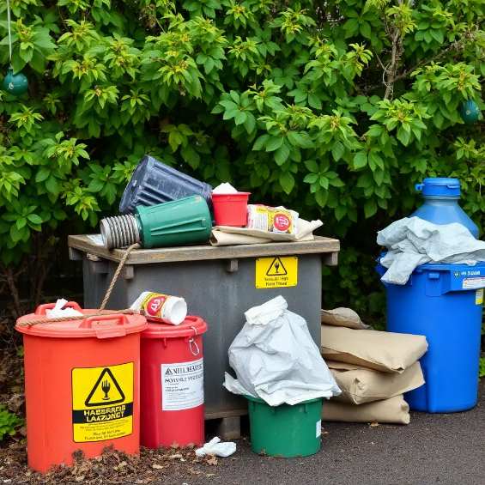
Best Practices for Hazardous Waste Disposal
Characterization: Identify waste composition and hazards.
Segregation: Separate hazardous from non-hazardous waste.
Documentation: Maintain thorough records for compliance.
Training: Educate personnel on safe handling and disposal.
Emergency Preparedness: Implement response plans for spills or accidents.
Dept of ECE

Slide 41
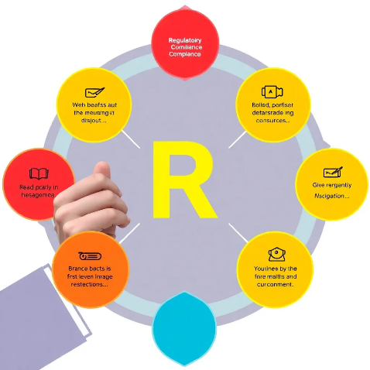
Regulatory Compliance and Standards
Overview: Compliance is essential for safe hazardous waste disposal.
Key Regulations:
RCRA: Governs hazardous waste management in the U.S.
Basel Convention: Regulates transboundary waste movement.
EU Waste Framework Directive: Sets waste management principles in the EU.
Compliance Requirements: Labeling, storage, disposal, and reporting standards.
Dept of ECE

Slide 42

Conclusion
Summary of Key Points: Effective disposal is crucial for health and environmental protection.
Importance of Waste Audits: Identify improvements and promote sustainability.
Call to Action for Industries: Develop comprehensive waste management plans and adopt pollution prevention measures.
Dept of ECE

Slide 43

Dept of ECE

Slide 44
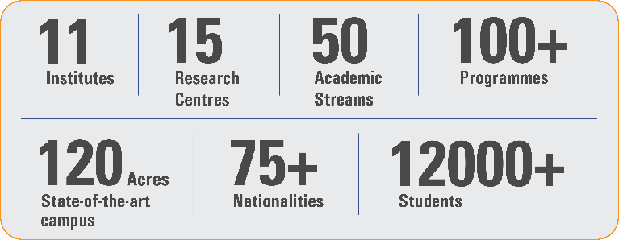
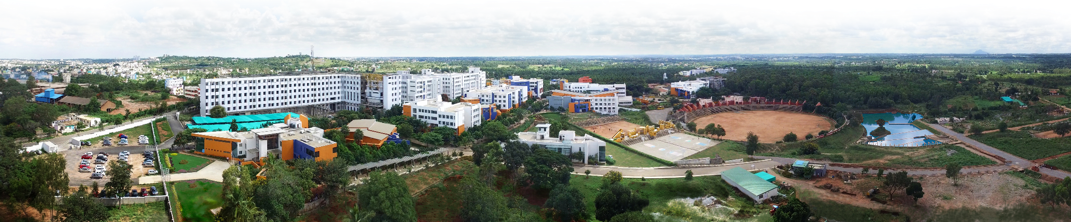
Overveiw
Acharya stands as a beacon of excellence in higher education, boasting a legacy of academic distinction since its establishment in 1990. We offer a transformative educational experience, fostering holistic development, nurturing innovation and providing world-class facilities to ensure an enriching journey for our students.
Dept of ECE

Slide 45

11 Institutions, Infinite Possibilities
We provide 100+ programs across 50 academic streams.
Dept of ECE

